Slide 1



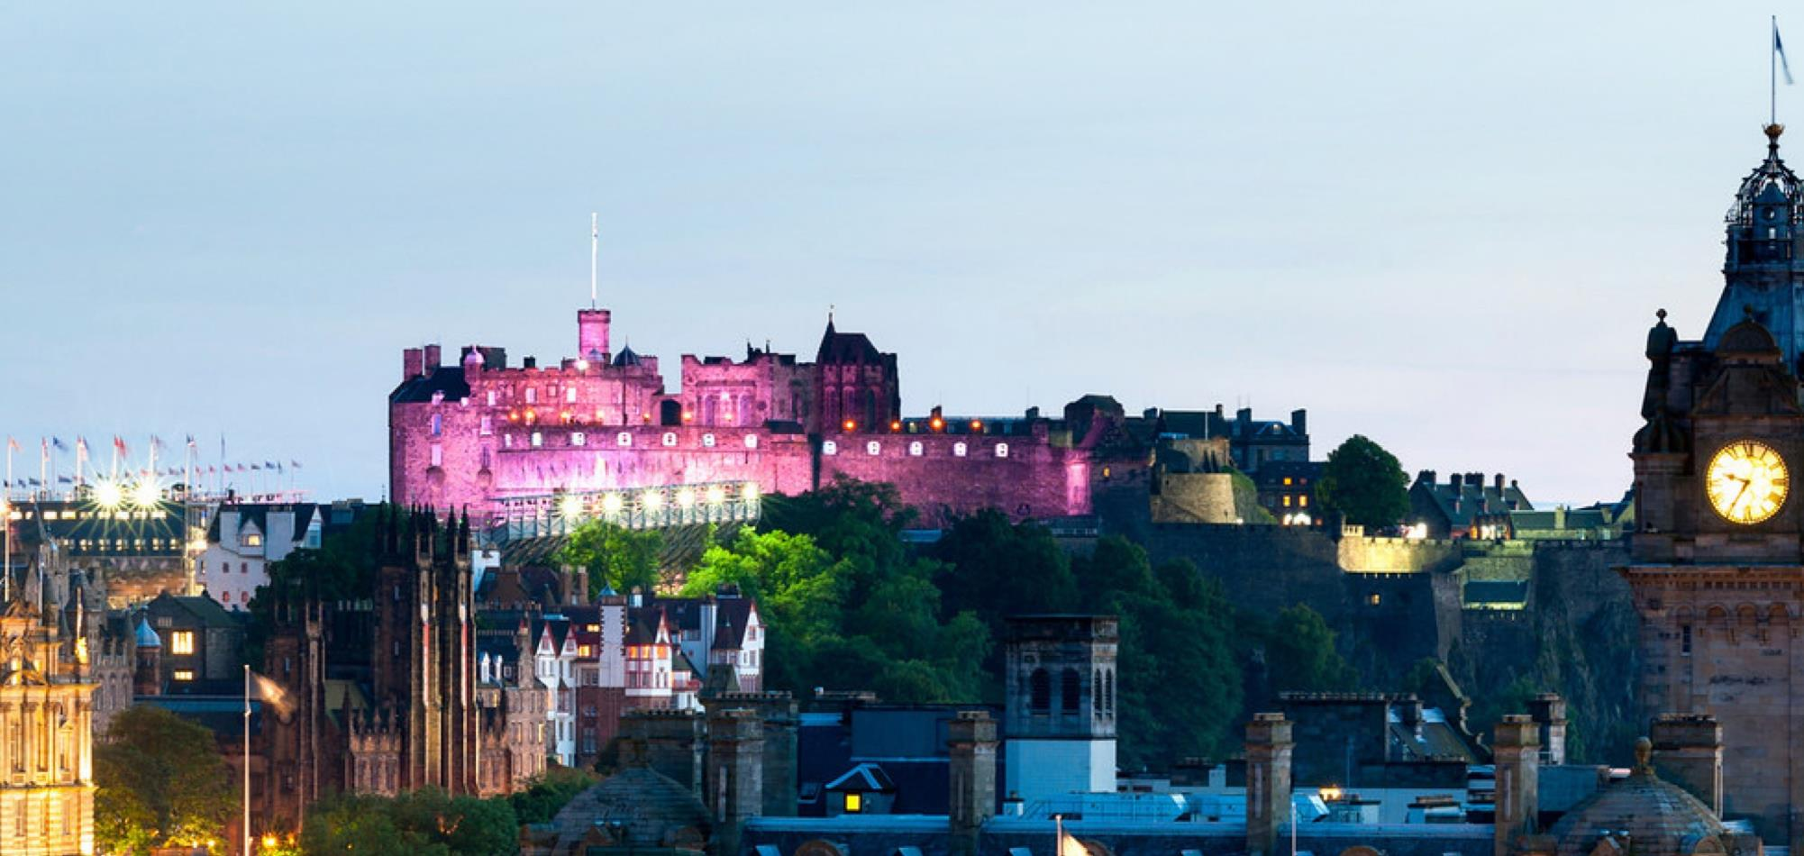
Edinburgh Earth, Ecology and Environment (E4)
Doctoral Training Partnership (DTP)

Slide 2
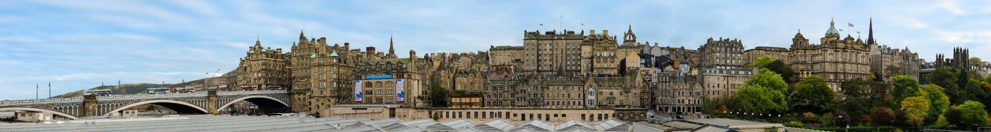
Welcome to the E4 DTP from:
Richard Essery – Director
Emma Cunningham – Deputy Director (Recruitment)
Massimo Bollasina – Deputy Director (Training)
Nicola Drago Ferrante – E4 DTP Manager
Cris Blyth – E4 DTP Support Administrator

Slide 3
E4 DTP management
External Advisory Board
Core Management Board
Widening Participation Panel
Training Management Board
Recruitment Management Board
Student Advisory Panel
Notes:
The Edinburgh Materials and Micro-Analysis Centre exists to provide integrated and interdisciplinary facilities for the application of microbeam analytical techniques to material analysis. The facilities are concerned with micron-scale investigations of the chemical composition, atomic structure and surface texture of both natural (mineral) and synthetic materials. Virtually all chemical elements and isotopes, in major or trace amounts, may be analysed with the available instrumentation.The majority of the instruments concerned are housed in the Grant Institute of the School of GeoSciences, with additional facilities in the School of Chemistry, both on the King's Buildings Campus of the University. The combined instrumentation and facilities have recently been extensively upgraded with a NERC-administered JIF grant and a ESPRC grant (both awarded in 2000-2001).
The Centre for Science at Extreem Conditions CSEC is a multi-disciplinary Centre at The University of Edinburgh designed to promote the study of materials at extremes of pressure and temperature, and in electromagnetic fields, using both in-house and synchrotron and neutron techniques.
CMSE is a research centre of the College of Science and Engineering. All the Schools of the College participate in its work and some 40 members of academic staff are members of CMSE.The role of the Centre is to promote high quality work in materials (broadly interpreted), emphasising multi-disciplinarity, within the College and beyond.
The fundamental raison d'腎re of SUERC is to provide to universities of the Scottish consortium collaborative access to expensive equipment and specialist expertise. This is a highly cost-effective way of adding value to their research, training and teaching activities. The main areas of strength are in geochemistry, radiochemistry and isotope biogeosciences and the Centre houses perhaps the most comprehensive suite of dating techniques available in the UK, particularly for processes operating within a few tens of metres of the Earth's surface over the last ten million years. Of the thirty or so national facilities operated by NERC, the Centre is host to five, viz. the Radiocarbon Dating Laboratory, the Argon Isotope Facility, the Life Sciences Stable Isotope Facility, the Isotope Community Support Facility and the Cosmogenic Isotope Analysis Facility.
CASIX, the Centre for observation of Air-Sea Interactions & fluXes, is a NERC Centre of Excellence in Earth Observation. Our scientific focus is on advancing the science of air-sea interactions and reducing the errors in the prediction of climate change. The primary goal is to quantify accurately the global air-sea fluxes of carbon dioxide (CO₂). CASIX will accelerate the exploitation of new Earth Observation satellite data to further the understanding of marine biogeochemistry in the Earth System. CASIX links NERC Centres, university groups and the Met Office to model ocean circulation and the ocean carbon cycle (click here to see a full list of partners).
CTCD The aim of the Centre for Terrestrial Carbon Dynamics is to solve the equations for the terrestrial carbon balance, at a variety of scales, by a combination of modelling and data. Key to improving current understanding is quantifying the uncertainties associated with such calculations and analysing how best to reduce such uncertainties.
NERC Data Assimilation Research Centre. The aim of the DARC is the assessment, combination and synthesis of Earth Observation data with numerical models in order to reproduce the evolution of the earth system and to forecast its behaviour.
Scottish Centre for Carbon Storage
The challenge of climate change requires innovative approaches to CO2 management. A new Research Centre in Edinburgh promises to deliver the R&D capability to create containment solutions to complement emissions reduction strategies. Joseph Black, Professor of Chemistry at the University of Edinburgh was first to isolate pure carbon dioxide ("fixed air") and discover its properties, presenting his thesis in 1754, and founded the world's first Chemical Society.

Slide 4
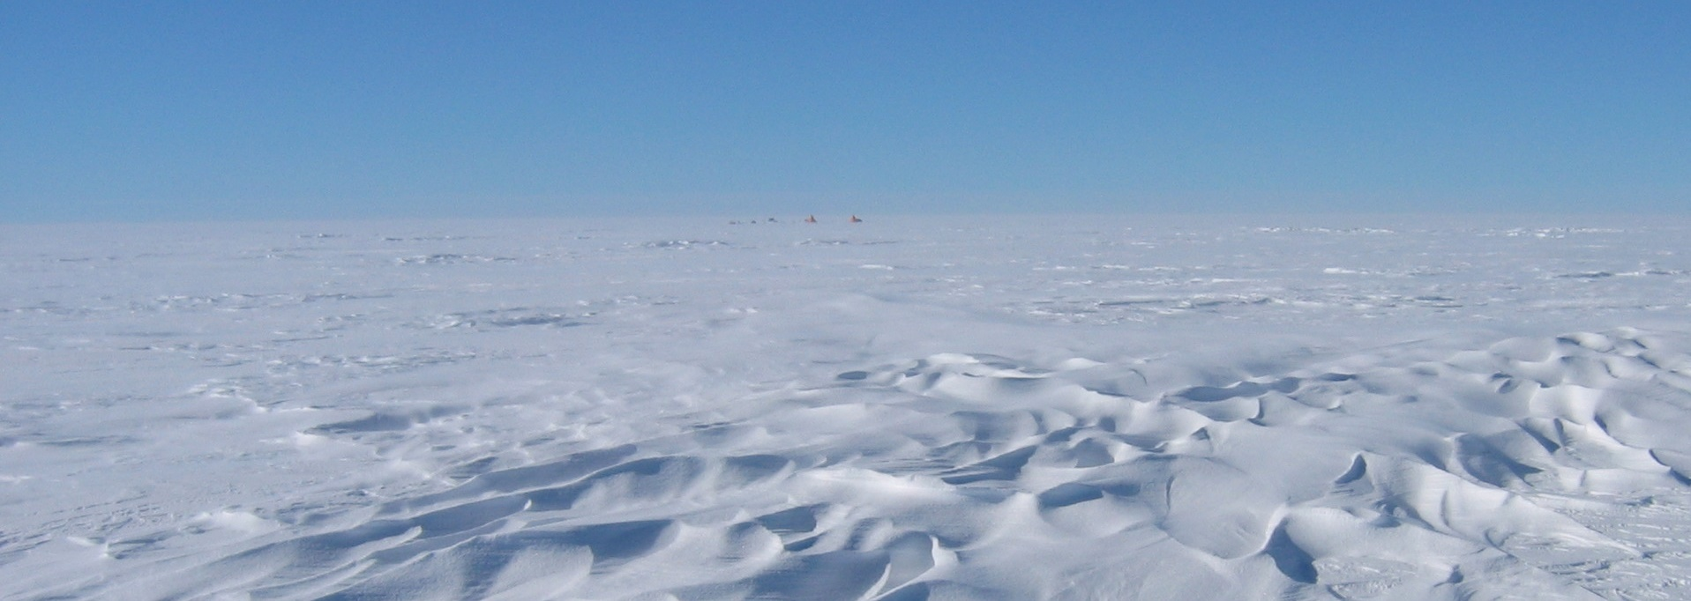
E4 DTP training
25 days of core training and 25 days of modular advanced training over the course of your PhD
Year 1 core courses:
Frontiers in Environmental Sciences
Numeracy, Modelling and Data Management
Residential workshop
Notes:
The Edinburgh Materials and Micro-Analysis Centre exists to provide integrated and interdisciplinary facilities for the application of microbeam analytical techniques to material analysis. The facilities are concerned with micron-scale investigations of the chemical composition, atomic structure and surface texture of both natural (mineral) and synthetic materials. Virtually all chemical elements and isotopes, in major or trace amounts, may be analysed with the available instrumentation.The majority of the instruments concerned are housed in the Grant Institute of the School of GeoSciences, with additional facilities in the School of Chemistry, both on the King's Buildings Campus of the University. The combined instrumentation and facilities have recently been extensively upgraded with a NERC-administered JIF grant and a ESPRC grant (both awarded in 2000-2001).
The Centre for Science at Extreem Conditions CSEC is a multi-disciplinary Centre at The University of Edinburgh designed to promote the study of materials at extremes of pressure and temperature, and in electromagnetic fields, using both in-house and synchrotron and neutron techniques.
CMSE is a research centre of the College of Science and Engineering. All the Schools of the College participate in its work and some 40 members of academic staff are members of CMSE.The role of the Centre is to promote high quality work in materials (broadly interpreted), emphasising multi-disciplinarity, within the College and beyond.
The fundamental raison d'腎re of SUERC is to provide to universities of the Scottish consortium collaborative access to expensive equipment and specialist expertise. This is a highly cost-effective way of adding value to their research, training and teaching activities. The main areas of strength are in geochemistry, radiochemistry and isotope biogeosciences and the Centre houses perhaps the most comprehensive suite of dating techniques available in the UK, particularly for processes operating within a few tens of metres of the Earth's surface over the last ten million years. Of the thirty or so national facilities operated by NERC, the Centre is host to five, viz. the Radiocarbon Dating Laboratory, the Argon Isotope Facility, the Life Sciences Stable Isotope Facility, the Isotope Community Support Facility and the Cosmogenic Isotope Analysis Facility.
CASIX, the Centre for observation of Air-Sea Interactions & fluXes, is a NERC Centre of Excellence in Earth Observation. Our scientific focus is on advancing the science of air-sea interactions and reducing the errors in the prediction of climate change. The primary goal is to quantify accurately the global air-sea fluxes of carbon dioxide (CO₂). CASIX will accelerate the exploitation of new Earth Observation satellite data to further the understanding of marine biogeochemistry in the Earth System. CASIX links NERC Centres, university groups and the Met Office to model ocean circulation and the ocean carbon cycle (click here to see a full list of partners).
CTCD The aim of the Centre for Terrestrial Carbon Dynamics is to solve the equations for the terrestrial carbon balance, at a variety of scales, by a combination of modelling and data. Key to improving current understanding is quantifying the uncertainties associated with such calculations and analysing how best to reduce such uncertainties.
NERC Data Assimilation Research Centre. The aim of the DARC is the assessment, combination and synthesis of Earth Observation data with numerical models in order to reproduce the evolution of the earth system and to forecast its behaviour.
Scottish Centre for Carbon Storage
The challenge of climate change requires innovative approaches to CO2 management. A new Research Centre in Edinburgh promises to deliver the R&D capability to create containment solutions to complement emissions reduction strategies. Joseph Black, Professor of Chemistry at the University of Edinburgh was first to isolate pure carbon dioxide ("fixed air") and discover its properties, presenting his thesis in 1754, and founded the world's first Chemical Society.

Slide 5

Stipend and funding extensions
Professional Internship Programme (PIP)
3-month stipend extension while embedded in an external organization (usually during years 2 or 3)
Professional Development Scheme (PDS)
2-month stipend extension for students who have submitted two first-author publications within 42 months
Overseas Research Visit and Conference Fund (ORVCF)
To support extra opportunities for international conferences and research visits abroad (2 calls per year)

Slide 6

























E4 DTP partners
Partner Schools
A partial list of Collaborative Partners (see the handbook for the full list)
Notes:
SAC (The Scottish Agricultural College) is an innovative, knowledge-based organisation, supporting the development of land-based industries and communities through our･specialist research and development resources･education and training provision･expert advisory and consultancy servicesOur work is wide ranging but there is a particular emphasis on agriculture and related sciences, rural business development and management, food chain quality and safety, and rural resource and environmental management.Through our associate company, SAC Commercial Ltd, we can provide a wide range of services to individuals, small and medium size enterprises, corporate clients, local and regional authorities, and government agencies and departments.Certain of our services in Scotland are assisted by the Scottish Executive Environment and Rural Affairs Department through its Grant-in-aid programme as part of the national provision for research and rural advisory services.SAC's Scotland-wide NetworkOur three main campuses are at Aberdeen, Ayr and Edinburgh, and there are 23 local advisory offices, eight veterinary centres and five research farms.Much of our work is in partnership with government departments, levy boards, other academic and research organisations, and local authorities.Commitment to ServicesWe are committed to providing the highest levels of service to all of our clients. See our 'Standards of Service'.
ur scientific programme has two key funding elements:･A Core Strategic programme funded from the UK government's Science Budget and administered through the Natural Environment Research Council (NERC). The programme entails long-term surveying, monitoring and databasing, underpinned by applied research. ﾊ･A Commissioned programme undertaken for clients but with an essential aim that it should enhance the public-good objectives of the Core Strategic programme.Understanding the Earth and the processes that shape it is fundamental to the successful development and sustainable management of our planet. The evolution of the Earthﾕs crust over geological time has resulted in diverse, often beautiful, landscapes formed by earthquakes, oceans, fire and ice. These landscapes are also a source of mineral wealth and water, a base for engineering projects and a receptacle for our waste. In order to safeguard the well-being of the planet, we need geological data and expertise to help us understand the complex interactions between the Earthﾕs shallow subsurface, water, air and living things.

Slide 7
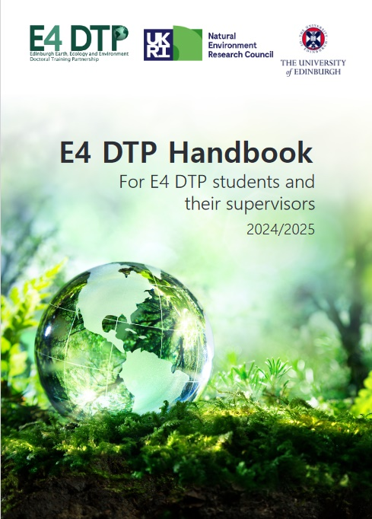
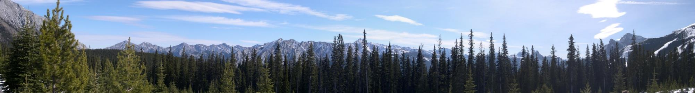
E4 DTP handbook
E4 DTP > Administration > Current Students > Handbook
DTP partners
Funding and studentship details
Policy, regulations and administration
Training
Expectations for students and supervisors
Notes:
The Edinburgh Materials and Micro-Analysis Centre exists to provide integrated and interdisciplinary facilities for the application of microbeam analytical techniques to material analysis. The facilities are concerned with micron-scale investigations of the chemical composition, atomic structure and surface texture of both natural (mineral) and synthetic materials. Virtually all chemical elements and isotopes, in major or trace amounts, may be analysed with the available instrumentation.The majority of the instruments concerned are housed in the Grant Institute of the School of GeoSciences, with additional facilities in the School of Chemistry, both on the King's Buildings Campus of the University. The combined instrumentation and facilities have recently been extensively upgraded with a NERC-administered JIF grant and a ESPRC grant (both awarded in 2000-2001).
The Centre for Science at Extreem Conditions CSEC is a multi-disciplinary Centre at The University of Edinburgh designed to promote the study of materials at extremes of pressure and temperature, and in electromagnetic fields, using both in-house and synchrotron and neutron techniques.
CMSE is a research centre of the College of Science and Engineering. All the Schools of the College participate in its work and some 40 members of academic staff are members of CMSE.The role of the Centre is to promote high quality work in materials (broadly interpreted), emphasising multi-disciplinarity, within the College and beyond.
The fundamental raison d'腎re of SUERC is to provide to universities of the Scottish consortium collaborative access to expensive equipment and specialist expertise. This is a highly cost-effective way of adding value to their research, training and teaching activities. The main areas of strength are in geochemistry, radiochemistry and isotope biogeosciences and the Centre houses perhaps the most comprehensive suite of dating techniques available in the UK, particularly for processes operating within a few tens of metres of the Earth's surface over the last ten million years. Of the thirty or so national facilities operated by NERC, the Centre is host to five, viz. the Radiocarbon Dating Laboratory, the Argon Isotope Facility, the Life Sciences Stable Isotope Facility, the Isotope Community Support Facility and the Cosmogenic Isotope Analysis Facility.
CASIX, the Centre for observation of Air-Sea Interactions & fluXes, is a NERC Centre of Excellence in Earth Observation. Our scientific focus is on advancing the science of air-sea interactions and reducing the errors in the prediction of climate change. The primary goal is to quantify accurately the global air-sea fluxes of carbon dioxide (CO₂). CASIX will accelerate the exploitation of new Earth Observation satellite data to further the understanding of marine biogeochemistry in the Earth System. CASIX links NERC Centres, university groups and the Met Office to model ocean circulation and the ocean carbon cycle (click here to see a full list of partners).
CTCD The aim of the Centre for Terrestrial Carbon Dynamics is to solve the equations for the terrestrial carbon balance, at a variety of scales, by a combination of modelling and data. Key to improving current understanding is quantifying the uncertainties associated with such calculations and analysing how best to reduce such uncertainties.
NERC Data Assimilation Research Centre. The aim of the DARC is the assessment, combination and synthesis of Earth Observation data with numerical models in order to reproduce the evolution of the earth system and to forecast its behaviour.
Scottish Centre for Carbon Storage
The challenge of climate change requires innovative approaches to CO2 management. A new Research Centre in Edinburgh promises to deliver the R&D capability to create containment solutions to complement emissions reduction strategies. Joseph Black, Professor of Chemistry at the University of Edinburgh was first to isolate pure carbon dioxide ("fixed air") and discover its properties, presenting his thesis in 1754, and founded the world's first Chemical Society.

Slide 8

Our expectations of you
Engage with your PhD and meet your supervisors regularly
Let us know about any issues as soon as they arise
Attend the core training activities (and if you cannot, let the organizers know)
Record training and activities in your Training and Outreach Log
Acknowledge the E4 grant number in publications
Read emails promptly and respond or act accordingly
Notes:
The Edinburgh Materials and Micro-Analysis Centre exists to provide integrated and interdisciplinary facilities for the application of microbeam analytical techniques to material analysis. The facilities are concerned with micron-scale investigations of the chemical composition, atomic structure and surface texture of both natural (mineral) and synthetic materials. Virtually all chemical elements and isotopes, in major or trace amounts, may be analysed with the available instrumentation.The majority of the instruments concerned are housed in the Grant Institute of the School of GeoSciences, with additional facilities in the School of Chemistry, both on the King's Buildings Campus of the University. The combined instrumentation and facilities have recently been extensively upgraded with a NERC-administered JIF grant and a ESPRC grant (both awarded in 2000-2001).
The Centre for Science at Extreem Conditions CSEC is a multi-disciplinary Centre at The University of Edinburgh designed to promote the study of materials at extremes of pressure and temperature, and in electromagnetic fields, using both in-house and synchrotron and neutron techniques.
CMSE is a research centre of the College of Science and Engineering. All the Schools of the College participate in its work and some 40 members of academic staff are members of CMSE.The role of the Centre is to promote high quality work in materials (broadly interpreted), emphasising multi-disciplinarity, within the College and beyond.
The fundamental raison d'腎re of SUERC is to provide to universities of the Scottish consortium collaborative access to expensive equipment and specialist expertise. This is a highly cost-effective way of adding value to their research, training and teaching activities. The main areas of strength are in geochemistry, radiochemistry and isotope biogeosciences and the Centre houses perhaps the most comprehensive suite of dating techniques available in the UK, particularly for processes operating within a few tens of metres of the Earth's surface over the last ten million years. Of the thirty or so national facilities operated by NERC, the Centre is host to five, viz. the Radiocarbon Dating Laboratory, the Argon Isotope Facility, the Life Sciences Stable Isotope Facility, the Isotope Community Support Facility and the Cosmogenic Isotope Analysis Facility.
CASIX, the Centre for observation of Air-Sea Interactions & fluXes, is a NERC Centre of Excellence in Earth Observation. Our scientific focus is on advancing the science of air-sea interactions and reducing the errors in the prediction of climate change. The primary goal is to quantify accurately the global air-sea fluxes of carbon dioxide (CO₂). CASIX will accelerate the exploitation of new Earth Observation satellite data to further the understanding of marine biogeochemistry in the Earth System. CASIX links NERC Centres, university groups and the Met Office to model ocean circulation and the ocean carbon cycle (click here to see a full list of partners).
CTCD The aim of the Centre for Terrestrial Carbon Dynamics is to solve the equations for the terrestrial carbon balance, at a variety of scales, by a combination of modelling and data. Key to improving current understanding is quantifying the uncertainties associated with such calculations and analysing how best to reduce such uncertainties.
NERC Data Assimilation Research Centre. The aim of the DARC is the assessment, combination and synthesis of Earth Observation data with numerical models in order to reproduce the evolution of the earth system and to forecast its behaviour.
Scottish Centre for Carbon Storage
The challenge of climate change requires innovative approaches to CO2 management. A new Research Centre in Edinburgh promises to deliver the R&D capability to create containment solutions to complement emissions reduction strategies. Joseph Black, Professor of Chemistry at the University of Edinburgh was first to isolate pure carbon dioxide ("fixed air") and discover its properties, presenting his thesis in 1754, and founded the world's first Chemical Society.

Slide 9






Student Support Services
University Student Support Services
Health
Wellbeing and mental health
Counselling
Sport and Exercise
Disability and Learning and Support
Student Immigration
Careers
Institute for Academic Development
Accommodation
Student Finance
Childcare
The Advice Place by EUSA (Edinburgh University Student Association)

Slide 10
Highlights from DTP alumni
Publications
Presenting at International conferences
The PIP (Professional Internship)
Training workshops, summer schools
Tutoring and Demonstrating
Winning / being nominated for awards
Independent fieldwork
Research visit and collaborations
Participating in Public engagement activities (Science Festivals e.g.)
Laboratory work

Slide 11

What would you have done differently?
Request more regular meeting with my supervisor
Ensure work and leisure activities are balanced throughout the PhD.
Attend more training while I had the chance!
Spend more time with your PhD pals, sharing ideas and experiences
Climb more Munros!
Sit straight and take regular breaks!
Volunteer for more outreach events and support groups
Nothing! You learn so well from your mistakes!
Start building network and reaching out to industry and professionals from the outset
Undertake a professional internship (PIP)
Train on statistical software earlier in the PhD
Start writing the thesis earlier
Six Things I wish I knew before starting a PhD

Slide 12
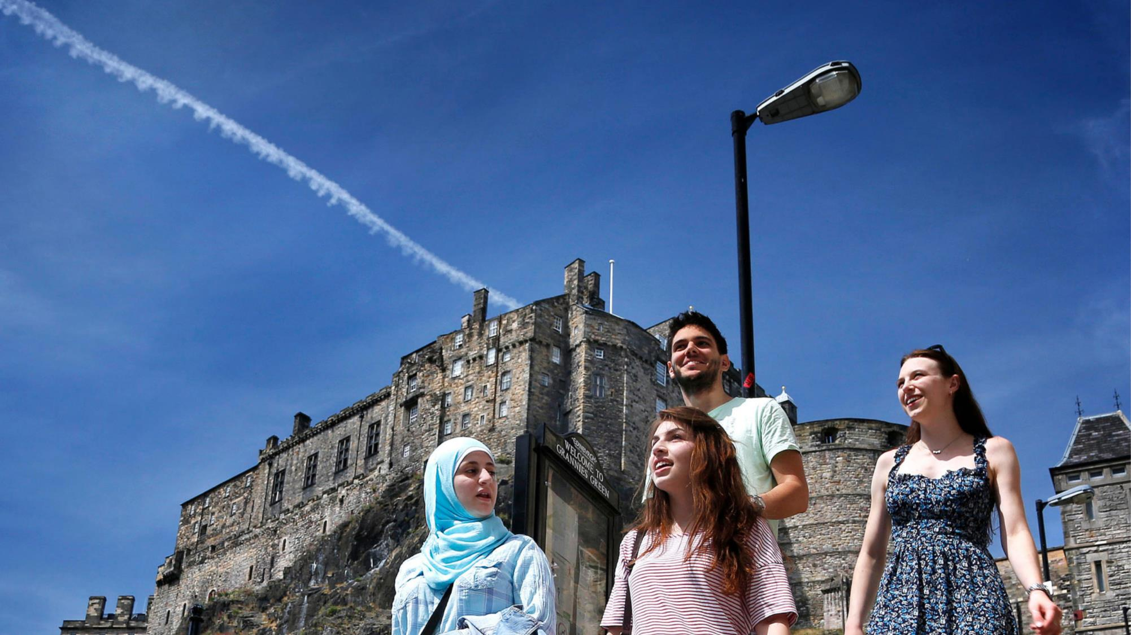
Questions?

Slide 13




Student-Led Coding Initiatives
Beginner Python Sessions
  Installing Python, data analysis, plotting figures
LaTeX Sessions
  Introductory course for academic writing
  Advanced sessions, Q&A, drop-ins etc.
Emails with more details will be sent closer to the sessions starting, likely later in semester 1 and into semester 2

Slide 14

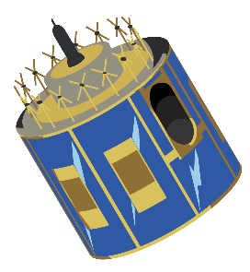
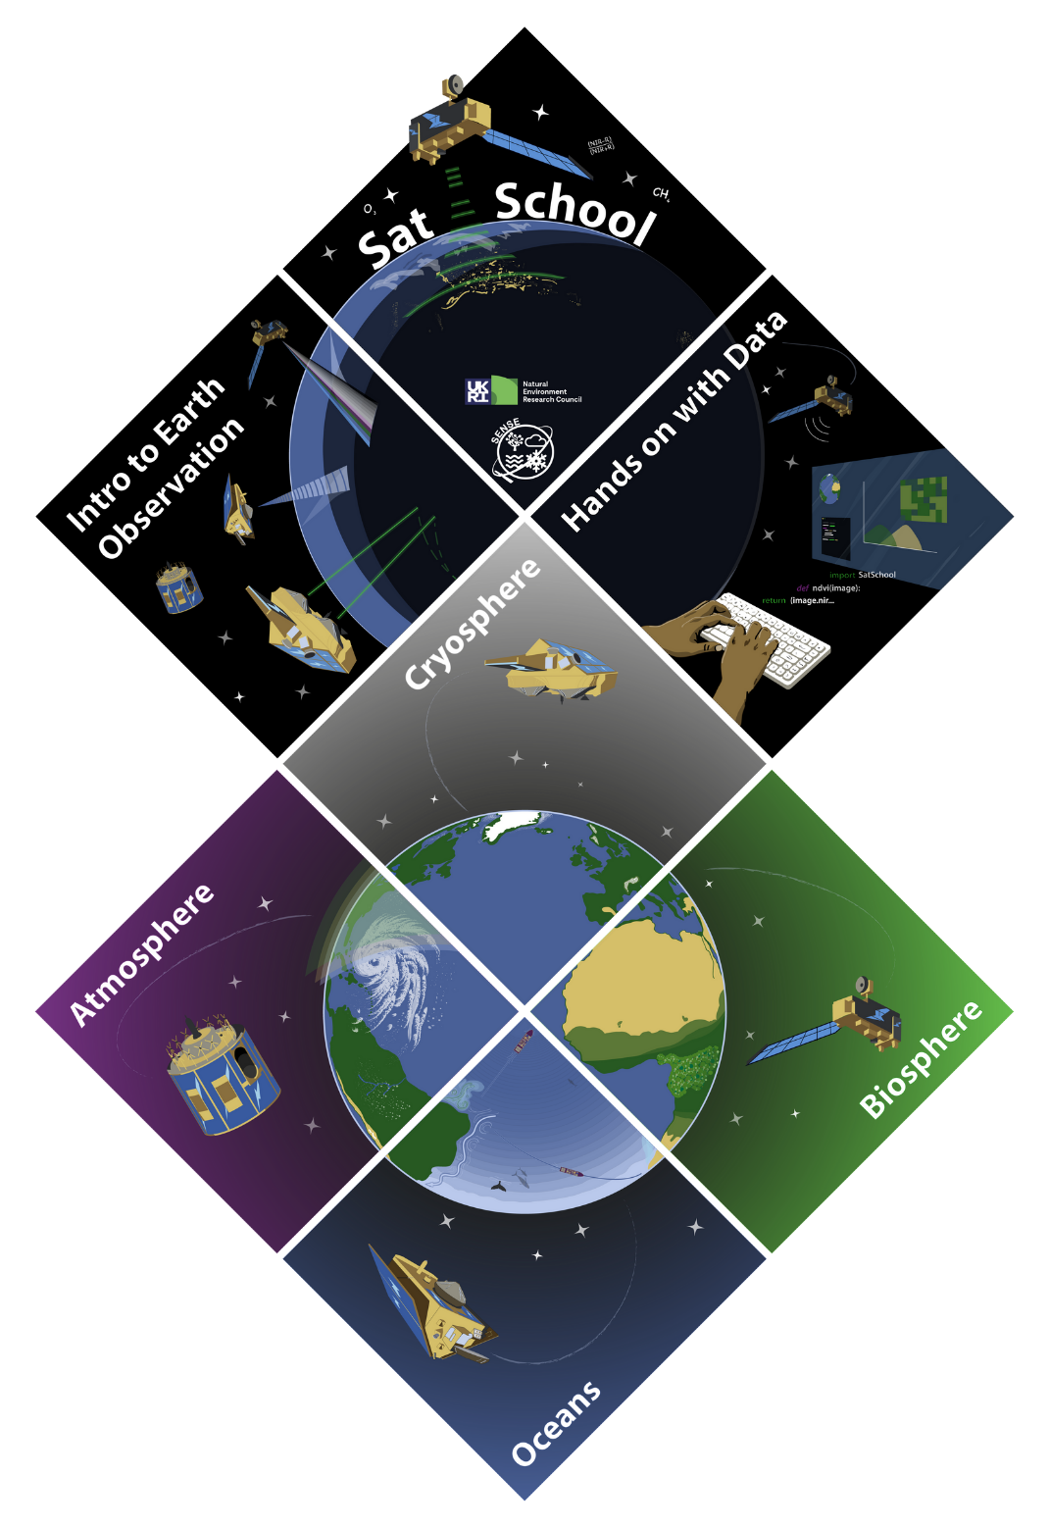

SatSchool Outreach
An outreach programme which:
Introduces Earth Observation concepts to KS3/S1-S3 (11-15 year old) pupils
Shows the relevance of school subjects in Earth Observation
Highlights the multitude of STEM career pathways available
Contains 12+ hours of outreach materials tied to school curriculum with 6 modules
Aims to ease the pressure on PhD students and staff doing outreach

Slide 15







Get involved!
EO Ambassador Network
Outreach is extremely valuable,
you can make a difference!
  Looking for volunteers to join our network.
  Outreach opportunities straight to your inbox.
  No commitment, join in whenever you want/can.
Join the committee -
AGM in November!
satschool-outreach@gmail.com
satschool-outreach.github.io
@SatSchool_

