Slide 1
Introduction to Career Pathways Thursday 27 April 2023, 10:00-16:00
10:00-12:30: Non-Academic Career Pathways
10:00-11:00: Ways of getting prepared throughout the PhD: Using existing opportunities to acquire/consolidate skills, build and maintain network in view of what comes after the PhD
10:00 | DTP training and opportunities - Kyle Dexter
10:30 | Tools and Services offered by the UoE Careers Service - Sarah Johnston
11:00: Comfort break
11:10-12:30 – Alumni share their professional pathway and experience [10-min presentations, followed by 30-min panel for questions]
11:10 | Alex Priestley, Learning Consultant and EUCOS Network Manager, Met Office
11:20 | Vanessa Burton, Conservation adviser, Woodland Trust, Edinburgh
11:30 | Andrew Griffiths, Sample Coordinator & Field Biologist, Royal Botanic Garden Edinburg
11:40 | Charlie Bunce, Head of Geospatial Technology at Trade in Space, Edinburgh
11:50 | Haydn Thomas, Head of Deposit Return Scheme Policy, Environment and Forestry Directorate at The Scottish Government, Edinburgh
12:00 | Question Panel
12:30: Lunch
13:30-16:00: Non-Academic Career Pathways
Photo by Xin on Unsplash

Slide 2
What is next

Slide 3
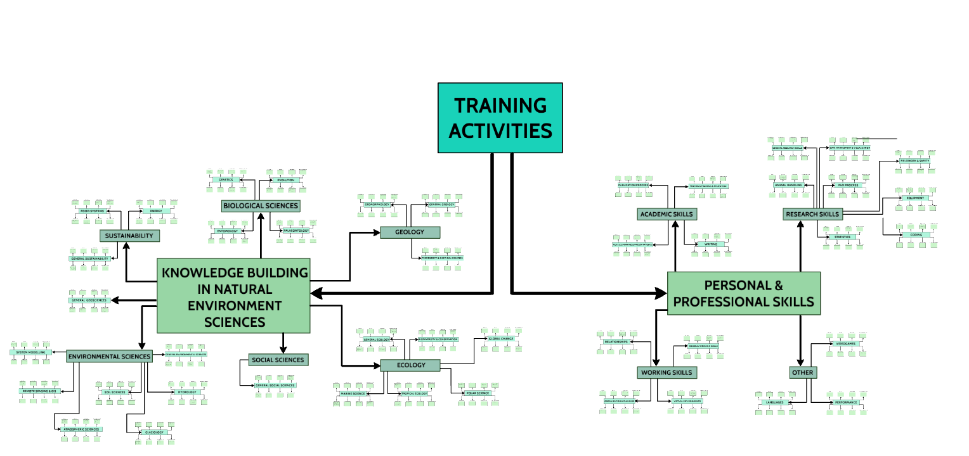
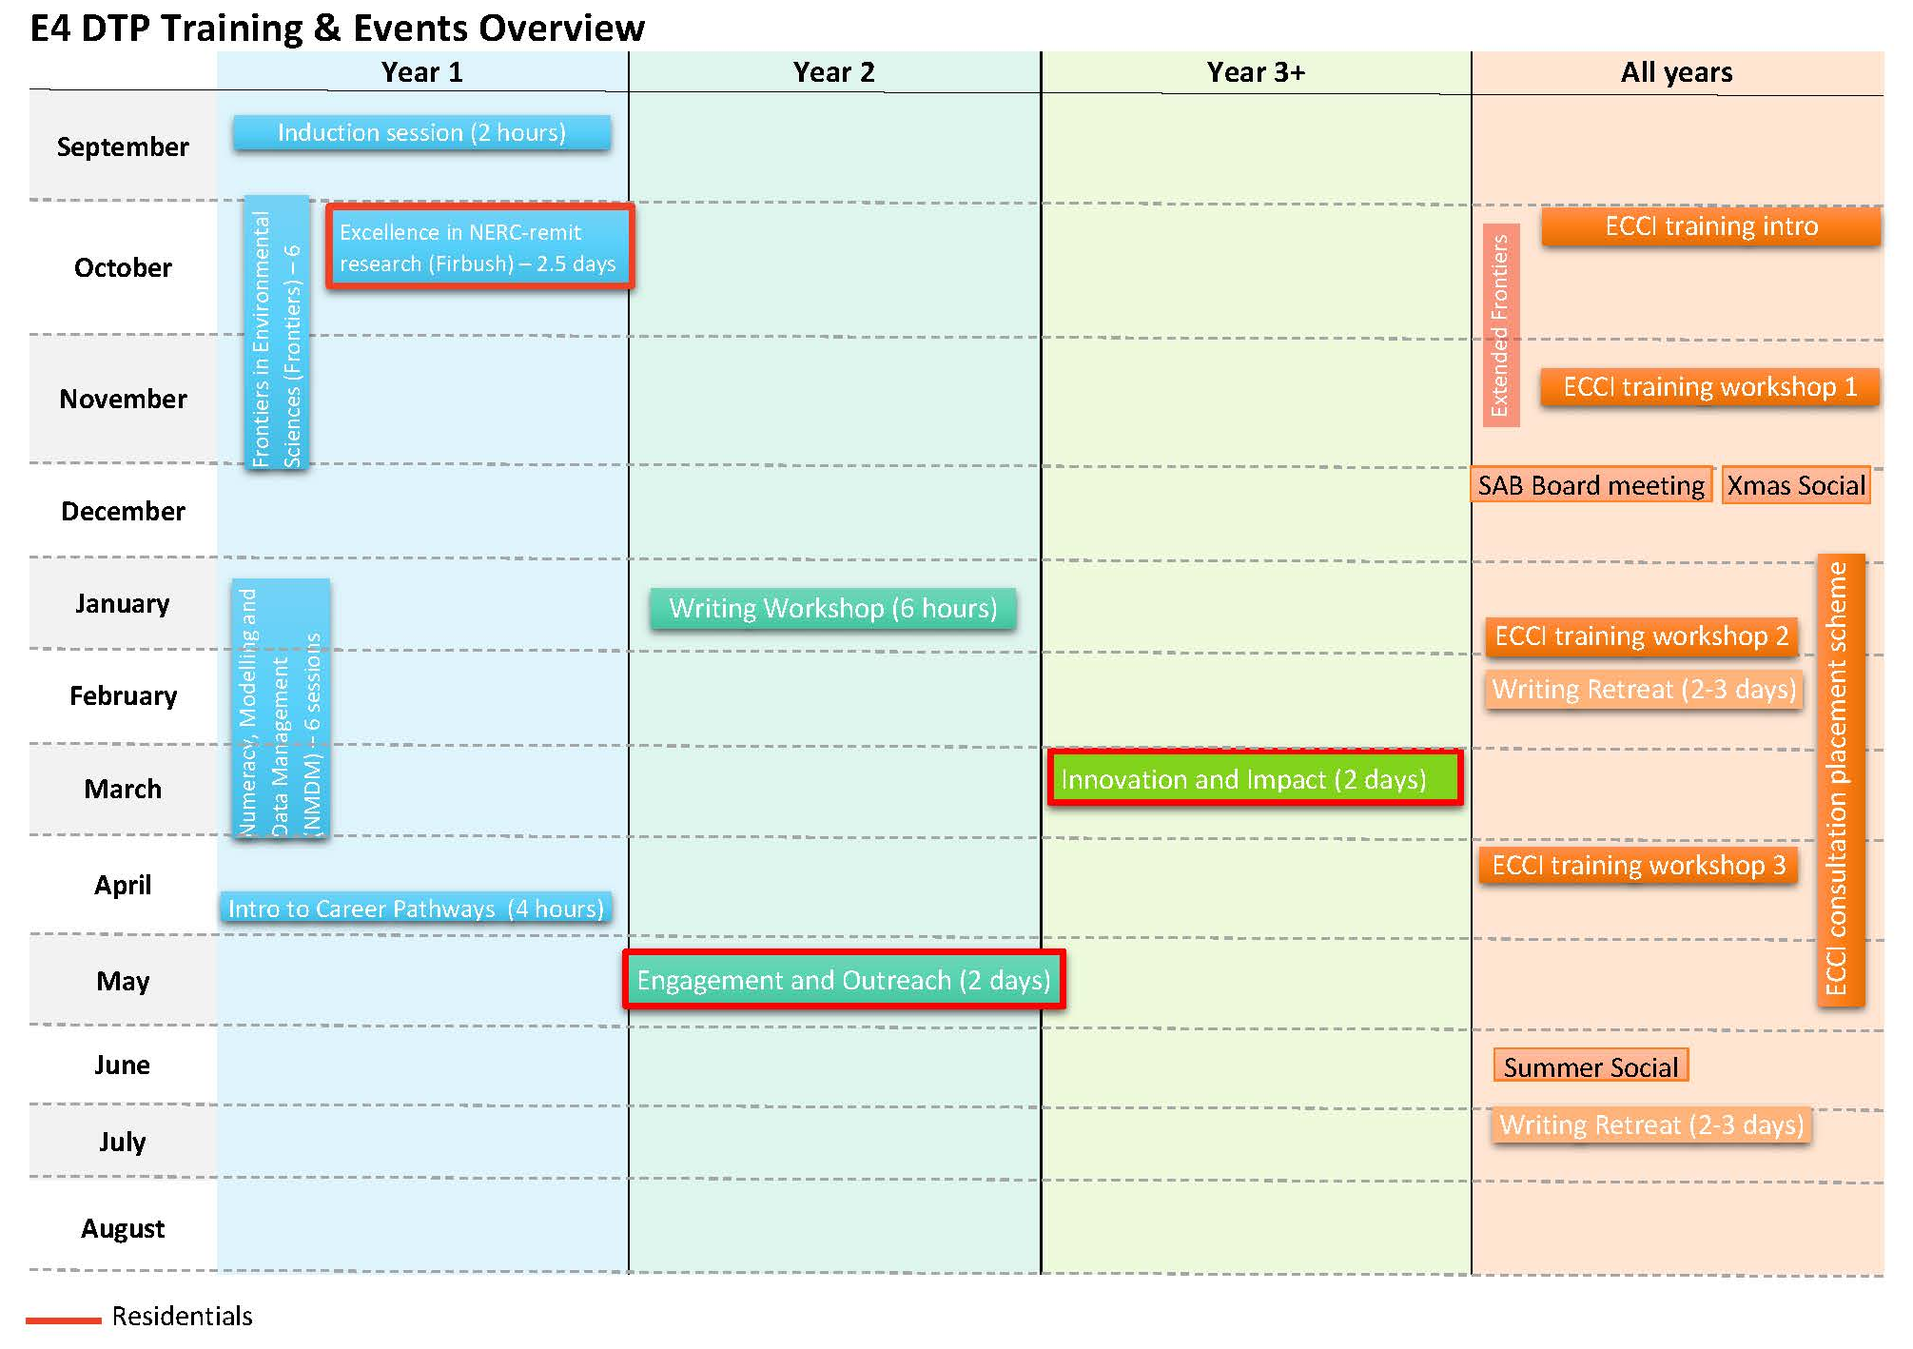
Getting prepared to your post-PhD during your PhD studies
Training
DTP training:
Generic/transferable skills (exploring NERC funding, writing, presenting, media and outreach, research impact and innovation) – including the ECCI training
Tailored training depending on your needs/project research
DTP training overview
Prezi

Slide 4
Getting prepared to your post-PhD during your PhD studies
Training
IAD training:
Research planning and management
Communication and Impact
Writing and publishing
Digital and Library Skills
Statistics
Personal Effectiveness
Public Engagement
Conference and Event Organising
Mindfulness-Based Wellbeing for Doctoral Students
Handling Presentation Difficulties (PGR)
Facilitation Skills for Public Engagement
Imposter Syndrome | Getting out of your own way
Networking and Personal Marketing Skills Workshop
Finding a balance: student and parenting responsibilities
Managing your work 1: your time, your energy and your goals

Slide 5
Getting prepared to your post-PhD during your PhD studies
2. Placements
E4 PIP – Professional Internship Placement
ECCI Consultancy placements
UKRI Policy internship and other UKRI funded placement opportunities such as Globalink (research placement)
Externally paid placement/work experience

Slide 6
Getting prepared to your post-PhD during your PhD studies
3. Tutoring and Demonstrating
IAD support: workshops and resources:
https://www.ed.ac.uk/institute-academic-development/learning-teaching/staff/tutors-demonstrators
Accreditation for tutors and demonstrators via the Higher Education Academy (HEA) & the Edinburgh teaching Award (EdTA)
https://www.ed.ac.uk/institute-academic-development/learning-teaching/staff/tutors-demonstrators/accreditation
Individual consultations

Slide 7
Getting prepared to your post-PhD during your PhD studies
4. Outreach opportunities
Working with young people
WP Primary Transitions: 30 min online practical science lessons with Primary 7 (age 11-12) in Widening Participation Schools in Edinburgh - Contact: Kay.Douglas@ed.ac.uk
Geoscience Outreach & Engagement course: PhD students support the development of Open Educational Resources (OERs) to schools worldwide. Full list of output: https://www.tes.com/teaching-resources/shop/OpenEd Contact: Kay.Douglas@ed.ac.uk
LEAPS (Lothians Equal Access Programme for Schools) local outreach programme that aims to raise awareness of opportunities in higher education and increase the number of students going to college or university. https://www.ed.ac.uk/studying/undergraduate/access-edinburgh/high-school-students/lothians-equal-access-programme-for-schools-leaps
Contact: wpteam@ed.ac.uk
Participating in festivals and public engagement events
Edinburgh Science Festival – Annual in April
Midlothian Science Festival
Pint of Science – 22-24 May 2023 (Worldwide)
Partners events (Dynamic Earth, RBGE, RSPB, CEH, Met Office etc.)
Social Medias events (online presentations)

Slide 8
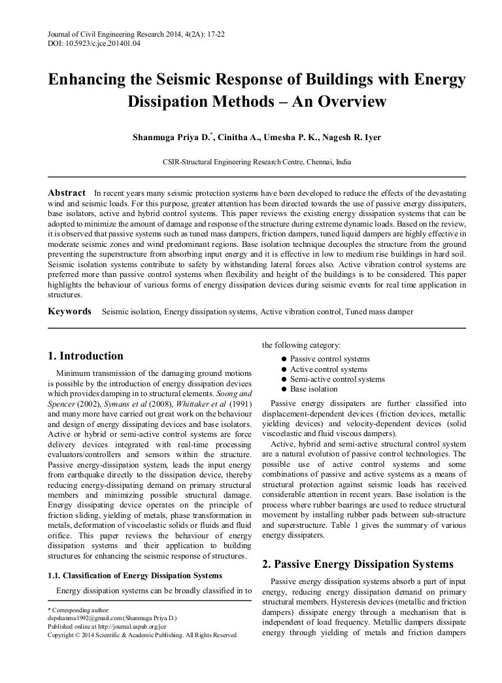
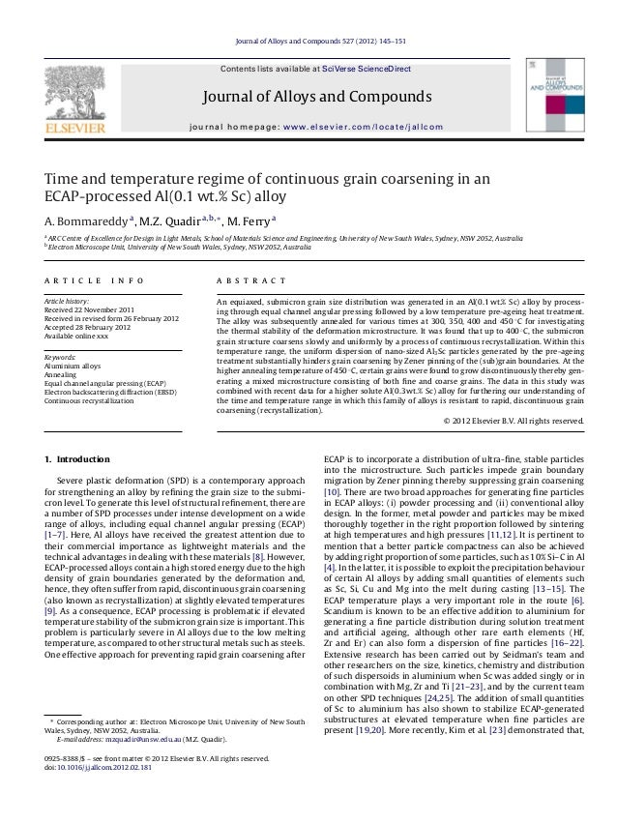
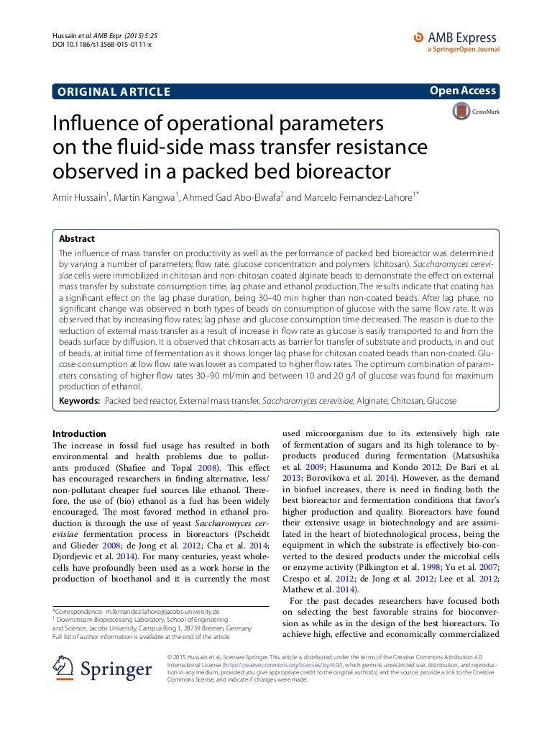
Getting prepared to your post-PhD during your PhD studies
5. Publications
E4 PDS scheme

Slide 9
Getting prepared to your post-PhD during your PhD studies
Training
2. Placements
3. Tutoring and Demonstrating
4. Outreach opportunities
5. Publications

